Slide 1
Artillery Duel .net
The first Internet game for the Commodore 64
Leif Bloomquist
Toronto PET Users Group
World of Commodore 2006

Slide 2
TCP/IP Stacks for the C64 in Machine Language
Services | TCP | DNS | DHCP | Echo
Transport |  | UDP |  | ICMP
Network | IP
Addressing | ARP
Ethernet driver | CS8900A / LAN91C96
Ethernet interface | RR-Net / TFE / ETH64
Green: Working Yellow: Partial Red: Unimplemented
IP65 – ca65 cross-assembler
Netlib64 – DASM cross-assembler
Image courtesy Per Olofsson

Slide 3
Internet Protocols
Transport Control Protocol (TCP)
    Guaranteed delivery of data + packet ordering
    Not implemented in ML yet, high overhead
    A lot of work for a poor 1Mhz computer
User Datagram Protocol (UDP)
    Much simpler protocol than TCP
    No guarantees – you do all the confirmation
    Working implementations in 6502 ML
    Used extensively in PC Internet gaming

Slide 4
Network Apps for the C64
Network apps so far have focused on utilities:
    Web Browsing / Telnet etc. (Contiki)
    Disk/Program Transfer (Warpcopy64)
    Terminal Software (GuruTerm)
    Remote debugging (CodeNet, UDPSlave)
Where are the games?

Slide 5
Simplifying Assumptions for First Attempt
Turn-based game, not timing critical
No central server – peer-to-peer
Only one packet “in flight” on network at any one time
Minimal game “world” and play

Slide 6
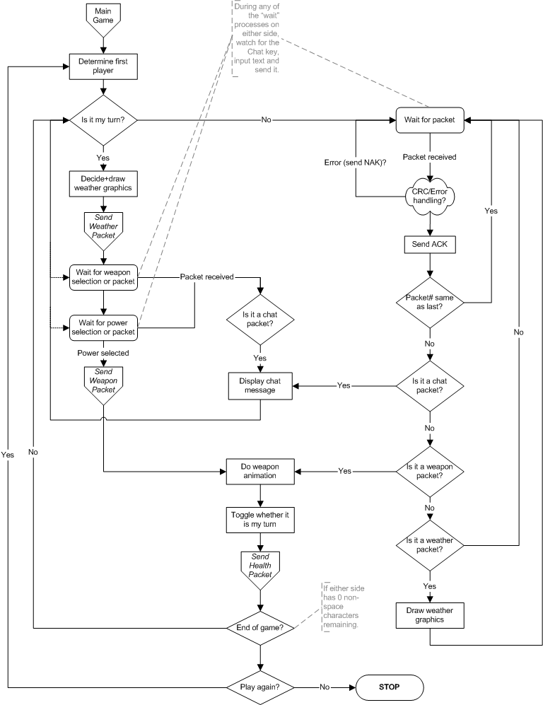
Game Logic Flowchart

Slide 7
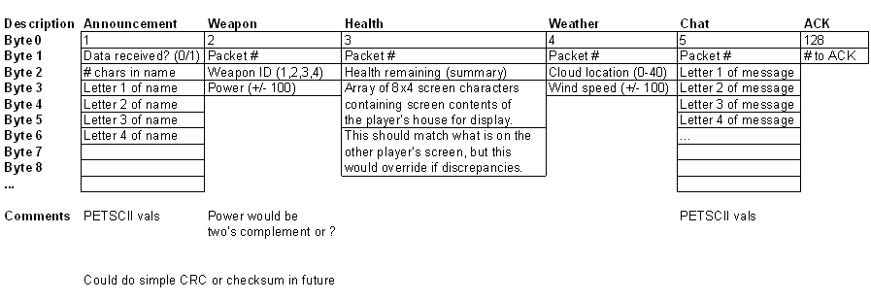
Very Simple Protocol

Slide 8
Where to get the Game
Grab a copy on disk from me today
Download latest version from www.petscii.com forums
(Network Game Development section)
Look for opponents on the #c64friends IRC channel (www.c64friends.com)

Slide 9
Credits:
Leif Bloomquist – Game code
Oliver VieBrooks – Network library code
Thurstan Johnston – Testing
Raik Picheta – Music
Also thanks to Dustin Chambers, Robin Harbron for ideas and assistance

Slide 10
Demo Time!

